Slide 1
NACHOS
Sannara Ek
Juan Vazquez
Shakeel Ahmad Sheikh
MoSIG M1 - GROUP E

Slide 2
Project Management
For steps 2, 3 and 4, the basic parts were done concurrently
Shakeel: Additional parts of Step2, Thread Join, Process Exit
Sannara: User Semaphores, Thread Join,
Juan: Files systems, Process Join

Slide 3
Outline
Multithreading
Thread Creation
Stack Management
Thread Join
Thread Exit
User Semaphore
Multiprocessing
Process Creation (ForkExec)
Exit of process
Waiting on Processes (UserWaitPID)
Filesystem
Directory Tree
Open Files Table and concurrent access
Increasing the file size

Slide 4
Thread Creation
Thread id is unique across its address space
Thread id is not being used even after the termination of a thread.
One to One mapping between NachOS user level threads and kernel level threads.
Inside a process threads share the same address space but has its own registers and stack.
Supporting Structure:
A counter, tidcounter,
A counter, livethreads,
A bit map, stackFrames
An array of semaphores, called createdThreads used for ThreadJoin

Slide 5
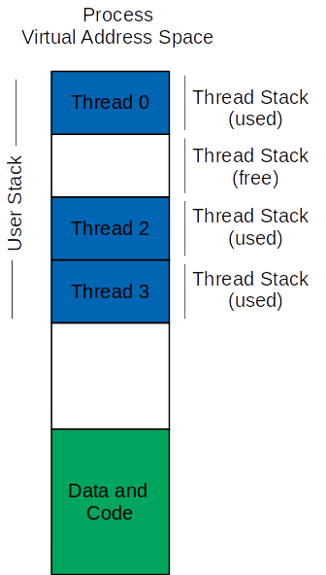
Stack Management
UserStackSize
User Stack is divided into frames
bitmap stackFrames, returns an integer value the frame number

Slide 6
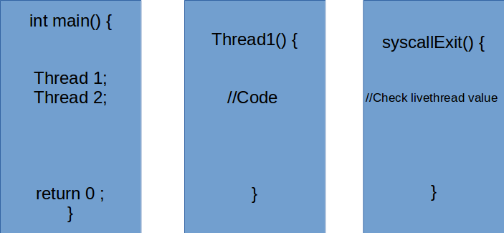
Thread Exit
What happens to child threads if the main thread returns i.e calls syscallExit() ?
Threads won’t have a chance to complete in this case.
Synchronised handler for syscallExit()
Livethreads Counter

Slide 7
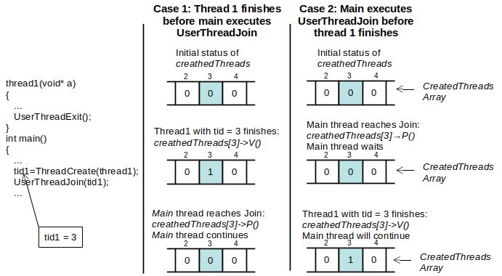
Thread Join
UserThreadJoin System call
createdThreads: Array of semaphores

Slide 8
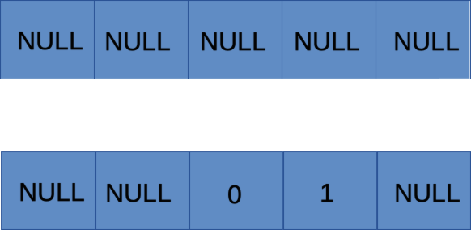
User Semaphores
A new sem_t data type that is based on ints which are used to represent semaphoresID
These IDs are used as the index in an array.
Functionalies & Implementation method
SemInit(sem_t *arg1, int arg2): UserSemaphores[semID] with the value from arg2
SemP(sem_t* arg): Calls the kernels wait on UserSemaphores[semID] on the index obtained from arg.
SemV(sem_t* arg): Call the kernels post on UserSemaphores[semID] on the index obtained from arg.

Slide 9
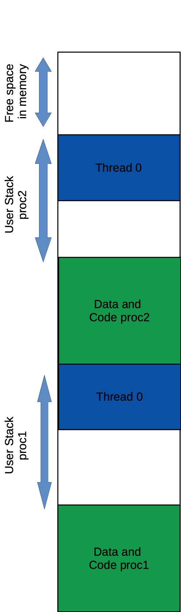
Fork Exec (Multiprocessing)
Process are created through the system call ForkExec()
Supporting Structure:
A counter, procounter,
A counter, livepro,
A bit map, frameProvider
A identifier, pro
Notes:
returns an error when executable is null unsigned int size = noffH.code.size + noffH.initData.size + noffH.uninitData.size + UserStackSize;

Slide 10
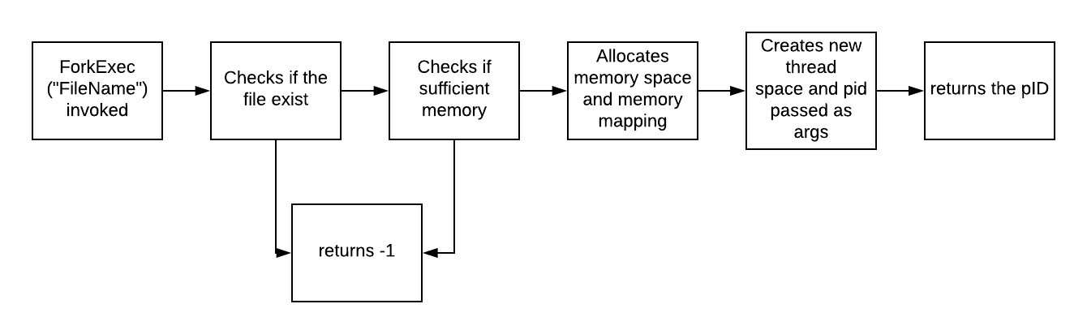
Fork Exec
Implementations:
Retrieves the file name passed obtained from the argument and attempts to open it with the function fileSystem->Open(Filename)
Checks if the the file else was executable
Checks if there is valid free memory through a function called CheckPhysicalSpace
An object called space, data typed addrSpace, will be declared for the new process
The construction of addrSpace for the new process maps frames in the physical memory to the page table and declares them as used through function GetEmptyFrame
The new thread is then created with fork, given, a pointer to space and to the value of procounter as an argument.
Notes:
frameProvider->GetEmptyFrame()

Slide 11
Managing processes exits
Extended system call Exit
A counter, livepro, is incremented and decremented every time a process starts and finishes
livepro is checked If its value is at 0.
If false, the ending process only releases its resources and memories
No Halt is called
Notes:
frameProvider->GetEmptyFrame()

Slide 12
UserWaitpID
Mechanism user is similar to userThreadJoin which was spoken earlier
An array of semaphores is used with process ID as indexes.
UserWaitPid(pid) will invoke a semaphore wait at the index of pid in the semaphore array, which causes the the calling process to wait until the desired process has finishes its work and call a semaphore post.
Notes:
frameProvider->GetEmptyFrame()

Slide 13
File System
Directory tree
Multiple open files
Concurrent access to files
A file can be opened multiple times inside a process
A file can not be open in mutiple processes at the same time
Maximun supported file size: 119,75KB

Slide 14
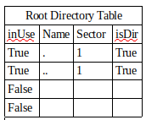
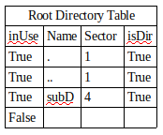
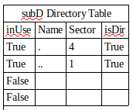


File System: Directory Tree
Executing cd subD from root directory:
The global variable currentSector is set to 4;
The global variable directoryFile point to subD file
mkdir subD
Root Directory Header
Root Directory Header
subD Header
Notes:
To create a Directory
Added a new field to the Directory Entry to differentiate files and directories.
Implemented function that creates a directory:
Add a new entry in the current directory, setting the th isDir field to TRUE
Write a new header with pointers to the data of the new directory
Update the Free Map
In the new subdirectory, two entries are added by default:
‘ . ‘ that points to the new subdirectory
‘..’ that points to the parent directory

Slide 15
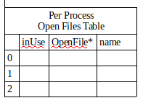
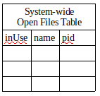
Open Files Table and Concurrent Access to Files
Two different processes cannot open the same file
A file can be opened by different threads running in the same process.
Two open files tables are implemented: one sistem-wide table, and one for each process
Each open() creates a new entry in the per-process open files table.
It may create an entry in the system-wide open files table
close() frees the corresponding entry in the per-process open files table.
It may free the corresponding entry in the system-wide open files table.
Notes:
Two different processes cannot open the same file.
- If a thread opens a file already open in the same thread or by another thread inside the same process, Each open() of a file in the same thread or by threads in the same process creates a new open file description; thus, there may be multiple open file descriptions corresponding to the same file. It is the the programmer to ensure consistent management between a file open multiple times in a process.
- close() frees only the corresponding file descripotor, passed as parameter. If is the last reference to the file in the current process, it also frees the corresponing entry in the system-wide open files table (so other process will be able to acces the file)
- There is a limit in the number of files that can be open in the system (how many?)
- There is a limit in the number of files that can be open per the proccess (how many?)
An open file cannot be deleted

Slide 16
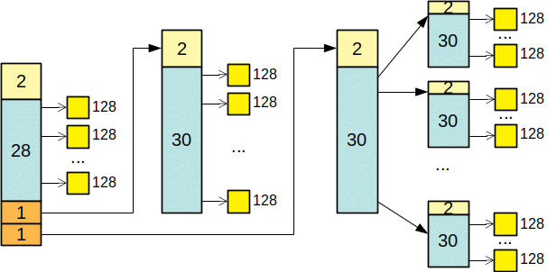
Increasing the Maximum File Size
Max Size = (28+30+30²) x 128 = 119,75KB

Slide 17
Conclusion
Working on this project made us really understand how an OS fundamentally works.
Our project has some limitations, but we had a tight time schedule. We also have some ideas how to fix them.
Git was a good tool to learn and explore.

Slide 18
Any Questions?

